Slide 1
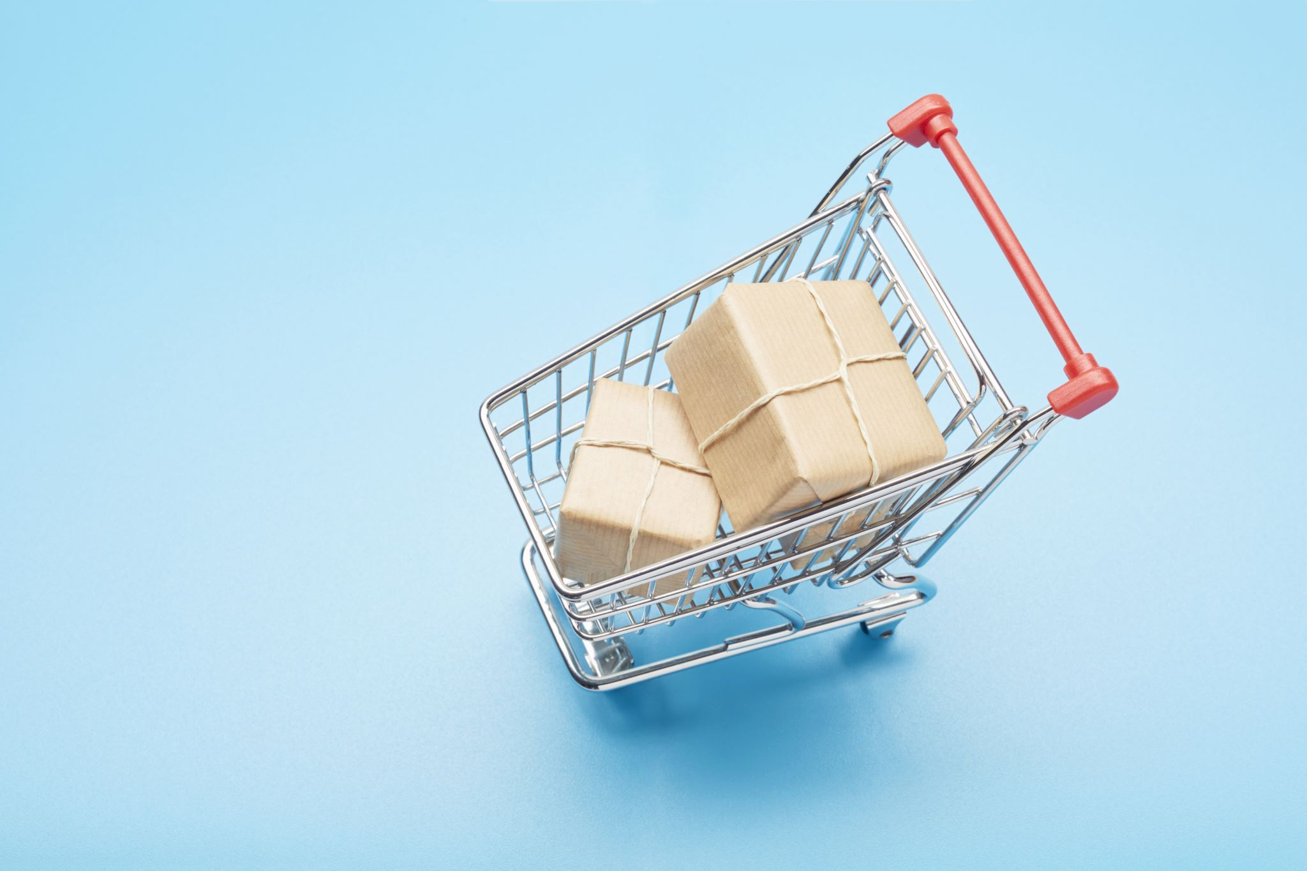
E-commerce System
Prog8620 – Data warehouse implementation
Kevin Obando 8848281
Harshpreet Singh 8872633
Navjot Kaur 8875242
Gagandeep Kaur 8851597
Upasana DHAMELIYA 8879401

Slide 2
eCommerce system – an overview
A comprehensive online platform that enables businesses and individuals to conduct commercial transactions over the internet.
Our eCommerce system leverages a robust database structure to enable online buying and selling activities.
It involves the buying and selling of products and services, as well as the associated activities and processes required to facilitate these transactions.

Slide 3
THE RELATIONAL DATABASE TABLES
The relational database consists of multiple tables that store crucial information about customers, products, orders, payments, reviews, promotions, and more.
These tables are interconnected to facilitate seamless transactions and comprehensive data analysis.

Slide 4
Operational database

Slide 5
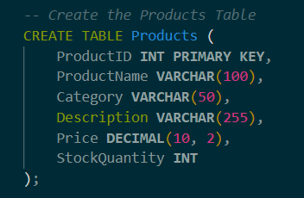
Product Management
The "Products" table stores product details such as names, categories, descriptions, prices, and stock quantities. This information forms the foundation of the digital storefront, allowing customers to explore and choose products to purchase.

Slide 6
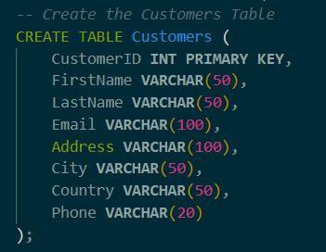
Customer Engagement
The "Customers" table holds customer data, including names, contact information, addresses, and more. Through customer accounts, users can manage their profiles, order histories, and saved information, enhancing their overall shopping experience.

Slide 7
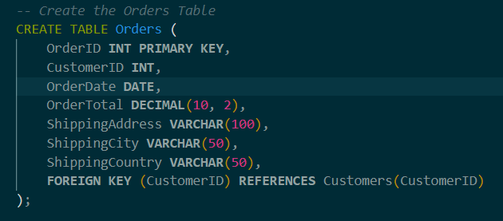
Order Processing
The "Orders" table records order-specific information, including order dates, total amounts, and shipping details. Customer orders are linked to their respective products and are processed, fulfilled, and tracked through this table.

Slide 8
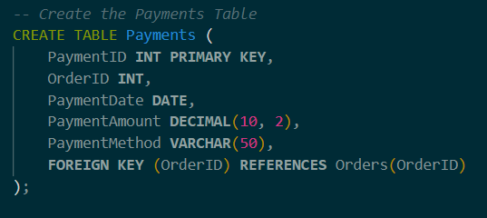
Payment Handling
The "Payments" table tracks payment-related data, including payment dates, amounts, and methods used. This facilitates secure and efficient transaction processing through integration with payment gateways.

Slide 9
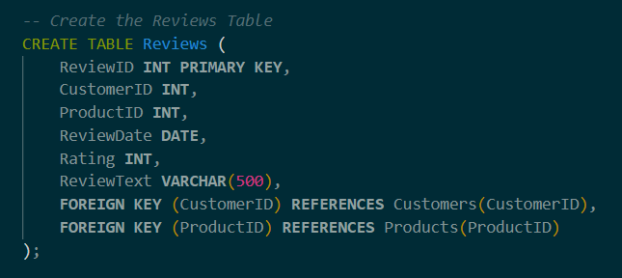
Customer Feedback
The "Reviews" table captures customer reviews of products, including ratings and textual feedback. This feedback not only informs other customers but also contributes to the overall product quality assessment.

Slide 10
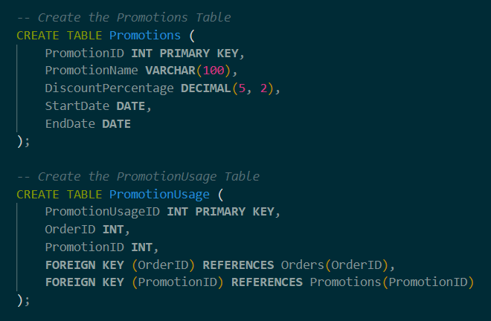
Promotions and Discounts
The "Promotions" table stores information about ongoing promotions, including names, discount percentages, and start/end dates. The "PromotionUsage" table links promotions to specific orders, helping in analyzing the effectiveness of various promotions.

Slide 11
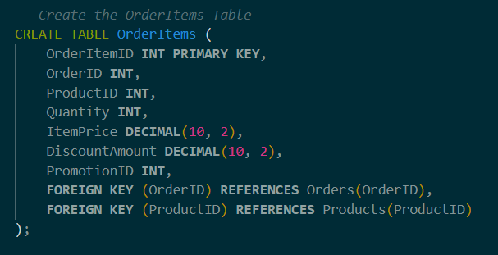
Order Details
The "OrderItems" table connects orders to individual products, tracking quantities, item prices, and associated discounts. This allows for accurate order fulfillment and invoice generation.

Slide 12
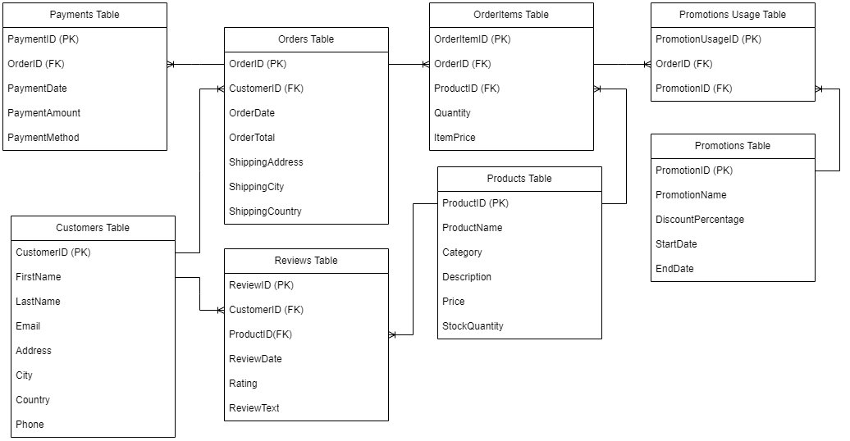
Entity relation diagram

Slide 13
The Data Warehouse

Slide 14
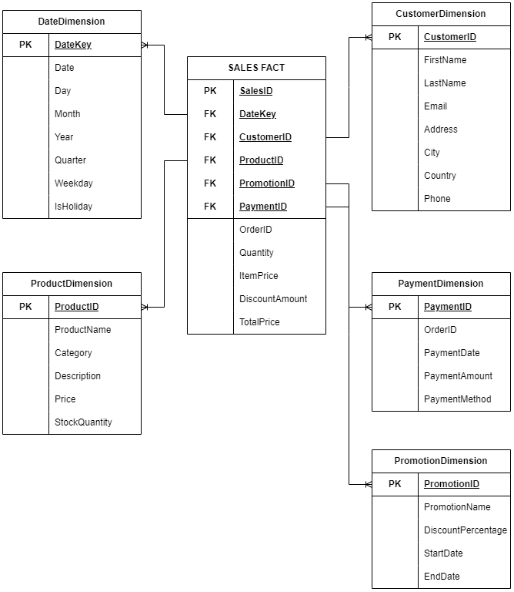
Star schema model

Slide 15
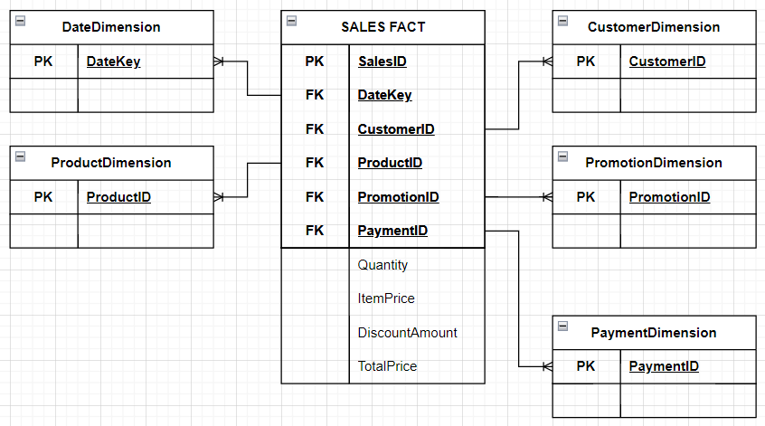
Designing the star schema
1. Decide on the dimensions and the measures
We want five dimensions and the facts we are interested in are about “Sales”.
The measures we care about are the quantity of sales, item price, discount and total price.
The fact table should have a foreign key to each of the dimension tables

Slide 16
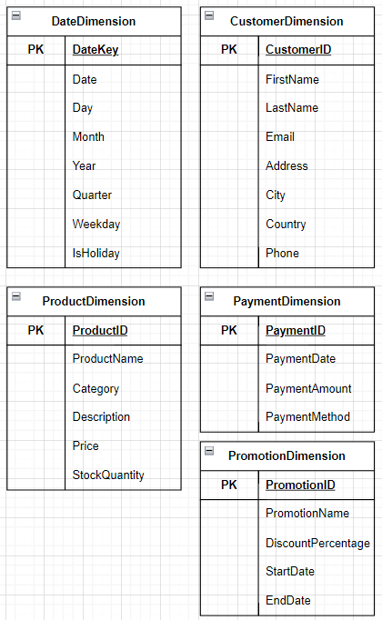
2. Decide the hierarchies for each dimension
DateDimension
What is the total sales per day?
… per month?
… per year?
… per quarter?
Was the order made on a weekday?
… on a holiday?
PromotionDimension
What is the promotion name?
What is the discount percentage?
When does the promotion start?
When does the promotion end?
ProductDimension
What is the product name?
What category does the product belong?
Short description of the product?
What is price of the product?
What is the stock quantity?
CustomerDimension
What is the customer first name?
… last name?
What is the customer email?
… address?
… city?
… country?
…phone?
PaymentDimension
When is the payment date?
What is payment amount?
What is the payment method?

Slide 17
3. Now we connect the tables to have our final Star Schema Dimension

Slide 18
Dimension tables

Slide 19
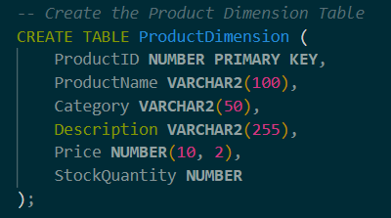
Product and Catalog Management
The ProductDimension table contains comprehensive information about each product, including product names, categories, and descriptions. This rich catalog data forms the core of the online storefront, allowing customers to explore products and make informed purchasing decisions.

Slide 20
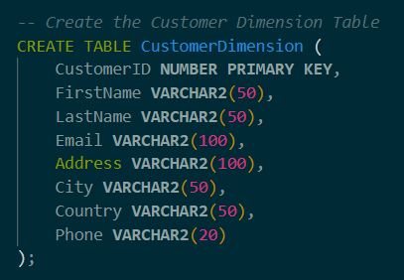
Customer-Centric Experience
The CustomerDimension table holds denormalized customer details, such as names, addresses, and contact information. By utilizing this table, customers can easily manage their profiles, track order histories, and receive personalized recommendations based on their preferences.

Slide 21
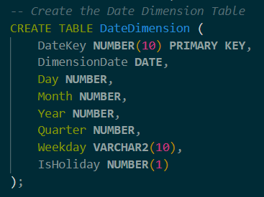
Temporal Insights with Date Dimension
The DateDimension table adds a temporal dimension to the system. It enables the analysis of sales trends over time by offering information such as day, month, year, and quarter. This dimension aids in understanding customer behavior and optimizing marketing strategies based on historical patterns.

Slide 22
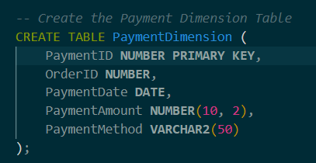
Comprehensive Payment Details
The PaymentDimension table enhances the system's payment processing capabilities. Linked to the SalesFact table, it stores critical payment-related data, such as payment dates, amounts, methods, and associated orders. This integration ensures smooth order processing, accurate financial tracking, and efficient customer service.

Slide 23
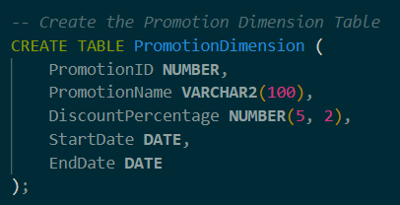
Effective Promotions Management
The PromotionDimension table captures the essence of promotional activities. It stores information about promotions, including names, discount percentages, and promotion periods. This data aids in creating targeted marketing strategies, evaluating promotion effectiveness, and optimizing sales campaigns.

Slide 24
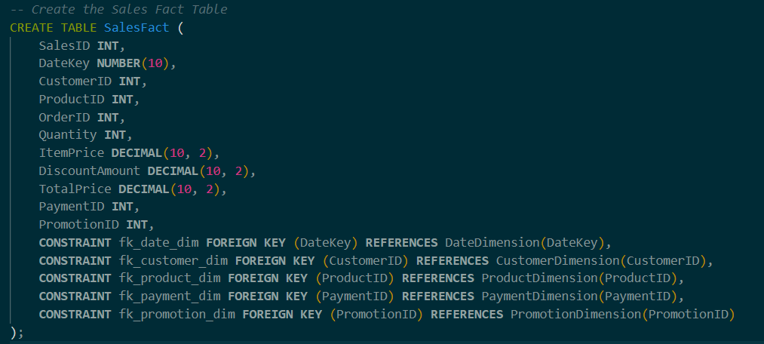
Strategic Sales Analysis and Reporting
The SalesFact table acts as the epicenter of transactional data integration. Through connections with dimensions like DateDimension, CustomerDimension, ProductDimension, PaymentDimension, and PromotionDimension, it provides a holistic view of sales metrics. This empowers businesses to delve into sales performance, customer behavior, and product popularity across various dimensions.

Slide 25
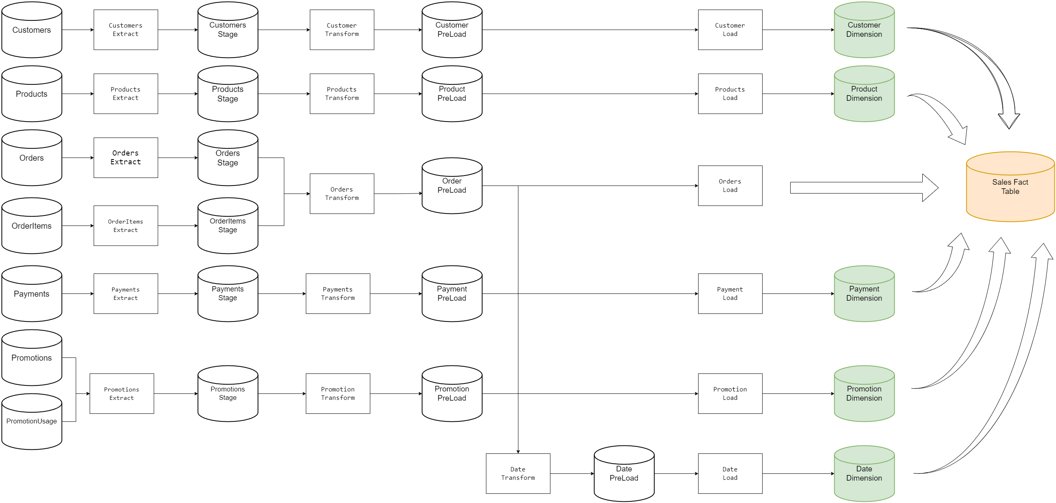
Extract – Transform - Load

Slide 26
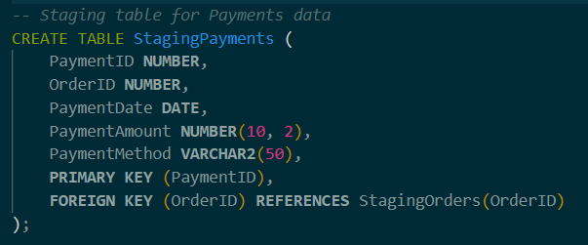
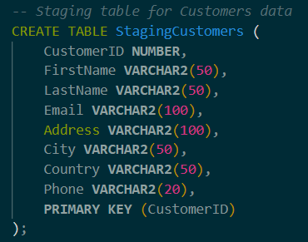
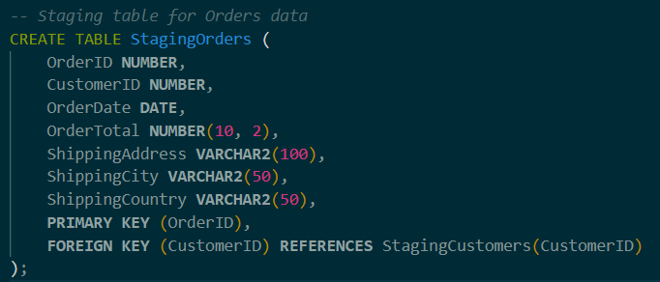
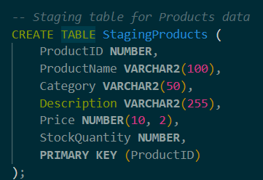
Staging Tables

Slide 27
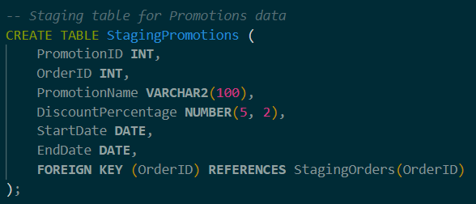
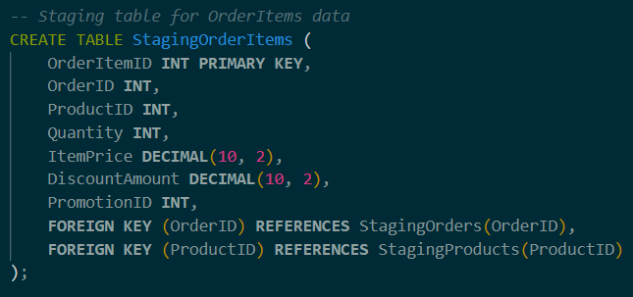
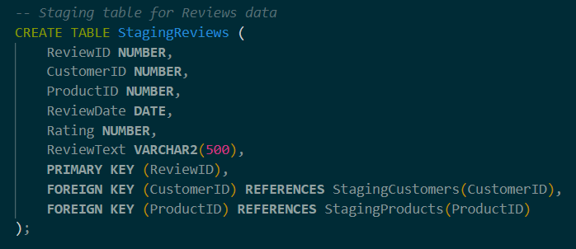
Staging Tables

Slide 28
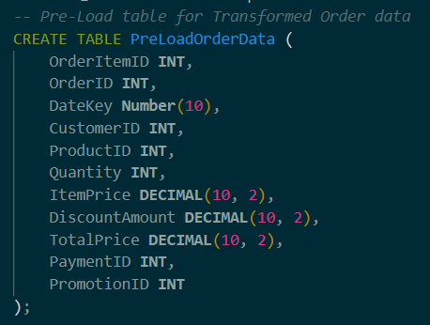
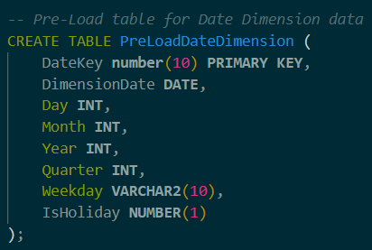
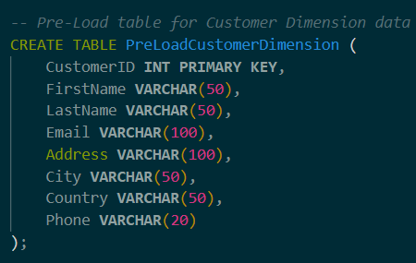
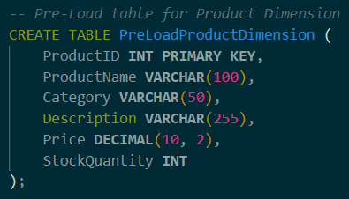
Preload Tables

Slide 29
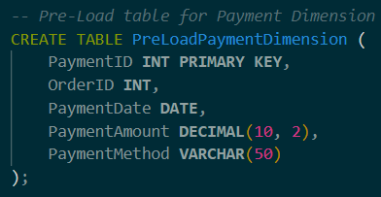
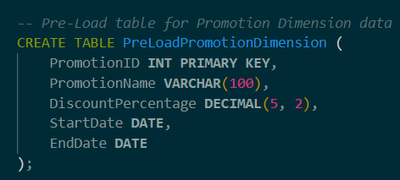
Preload Tables

Slide 30
Stored procedures
PopulateStagingTables
PopulatePreLoadTables
PopulateDateDimension
PopulateCustomerDimension
PopulateProductDimension
PopulatePaymentDimension
PopulatePromotionDimension
PopulateSalesFact

Slide 31
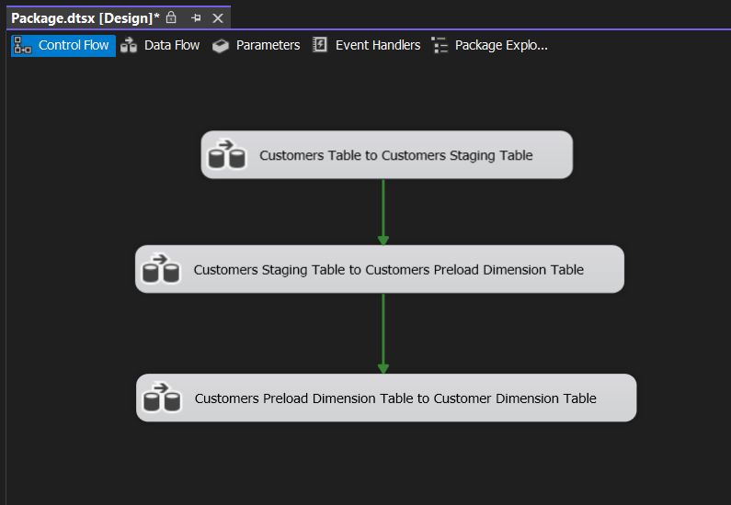
SSIS Package (Customers)

Slide 32
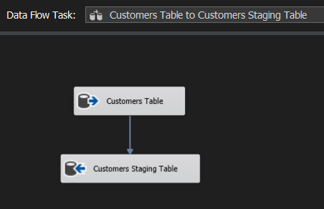
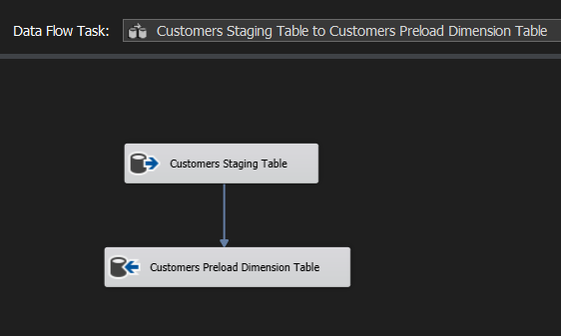
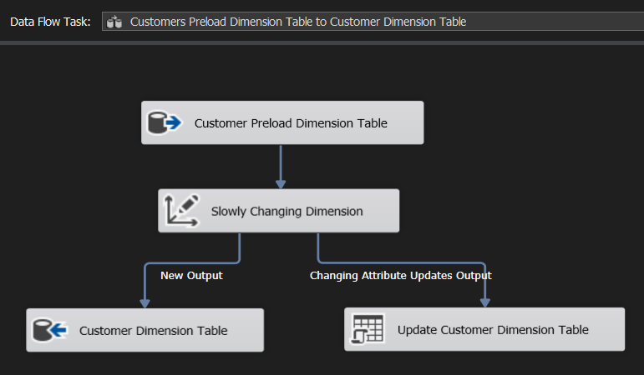
SSIS Package (Customers)

Slide 33
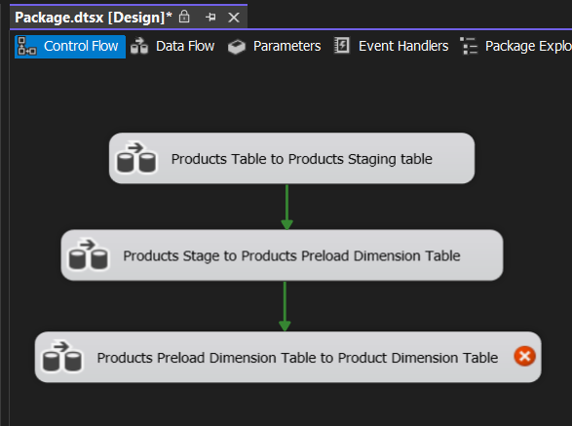
SSIS Package (Products)

Slide 34
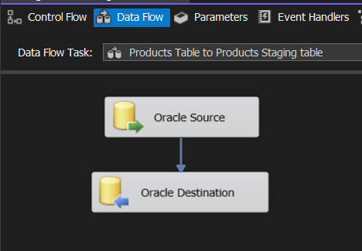
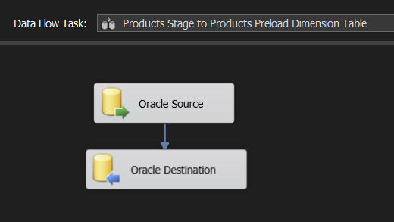
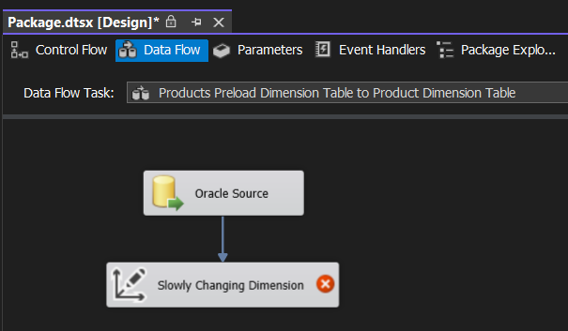
SSIS Package (Products)

Slide 35
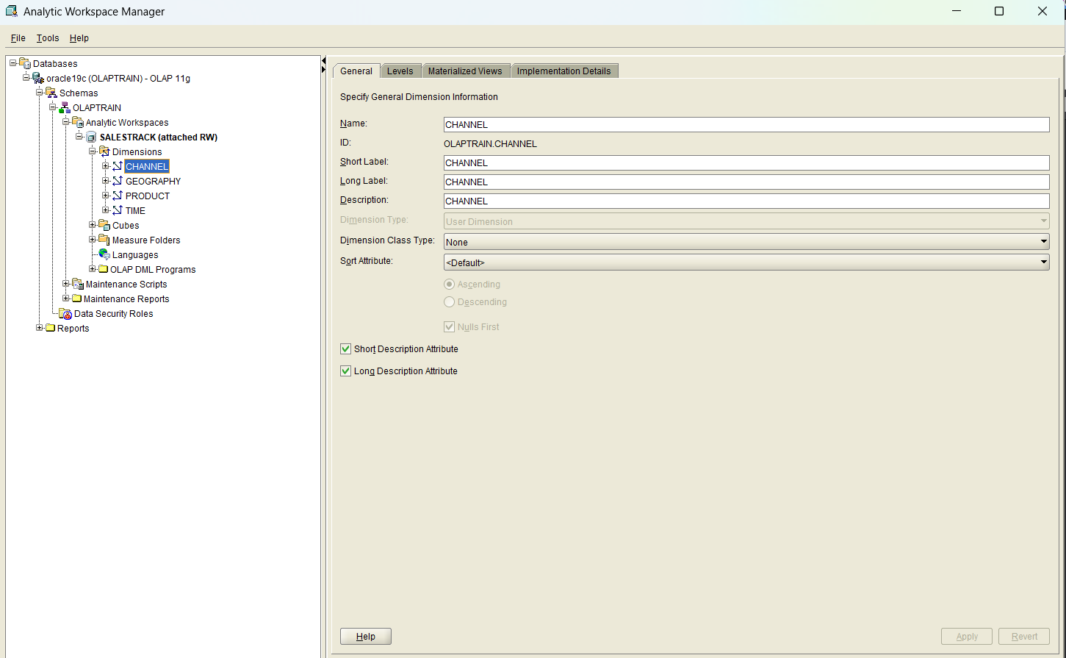
OLAP CUBE

Slide 36
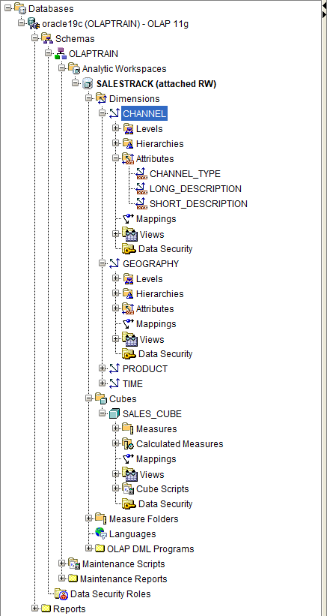
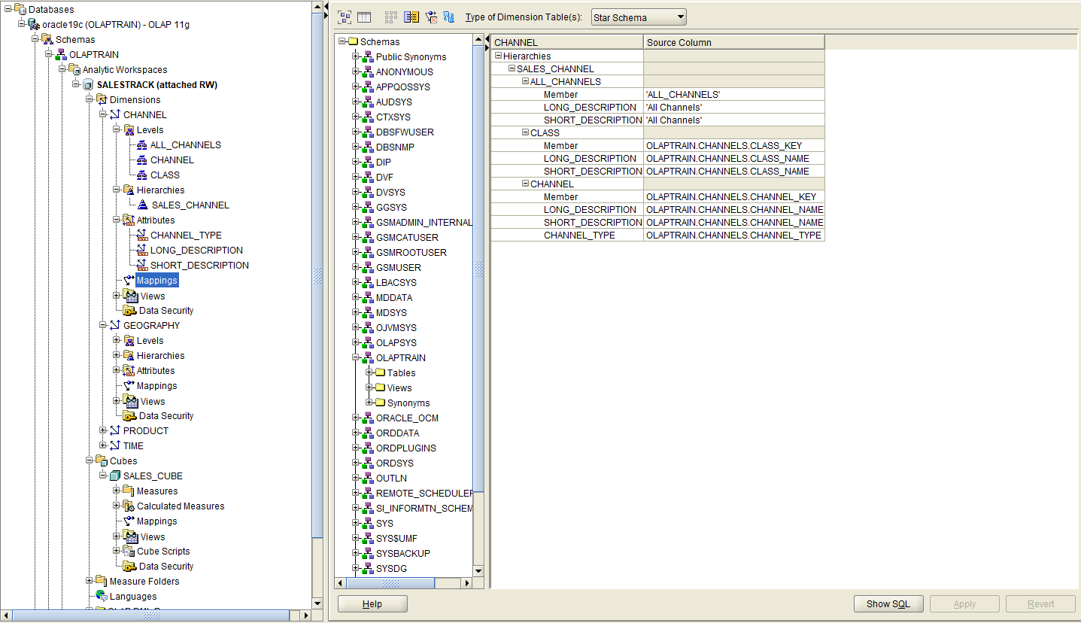
OLAP CUBE

Slide 37
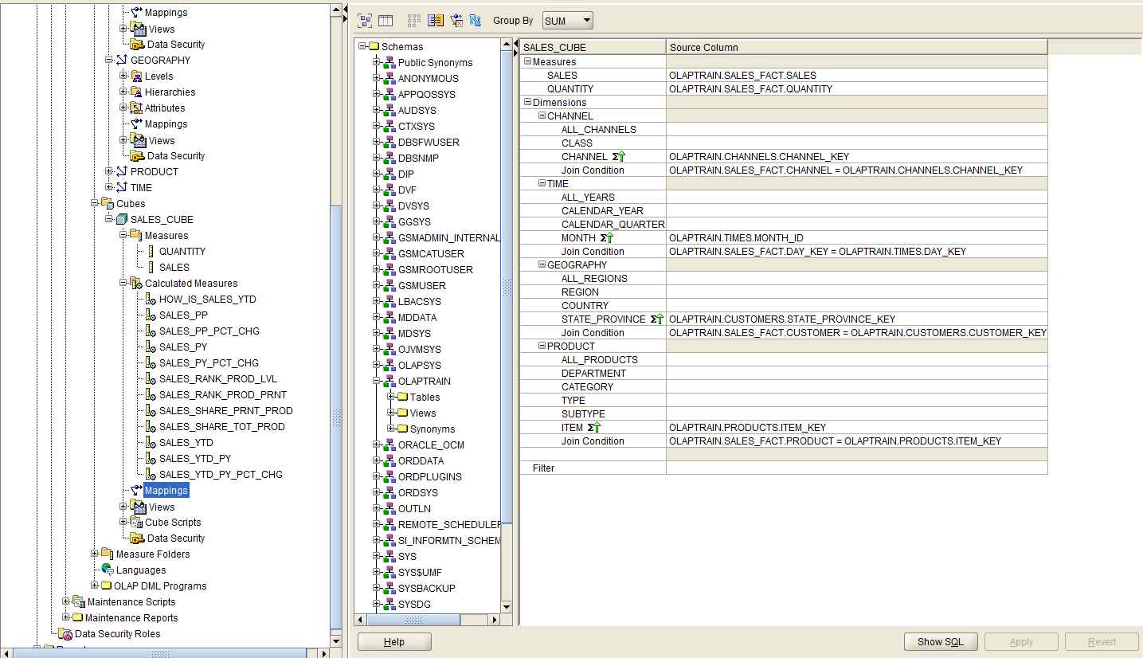
OLAP CUBE

Slide 38
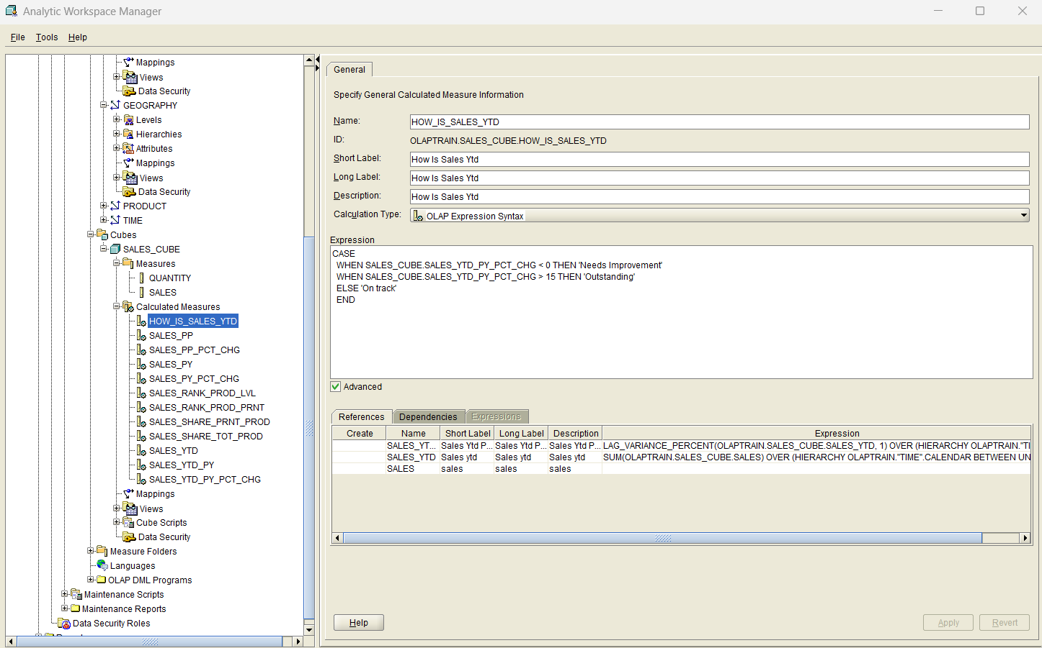
OLAP CUBE

Slide 39
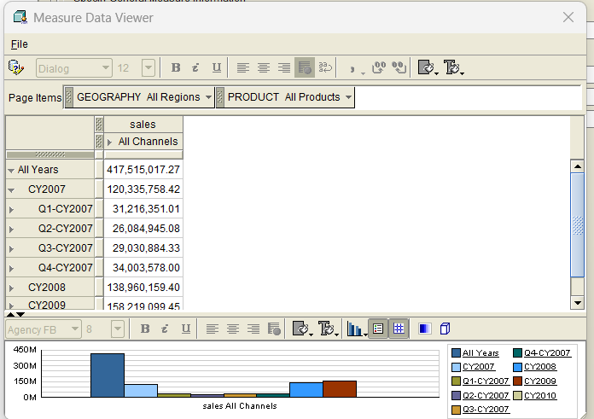
OLAP CUBE

